Slide 1






MySQL
Project
Restaurant Business:
Menu, Orders, and Sales

Slide 2

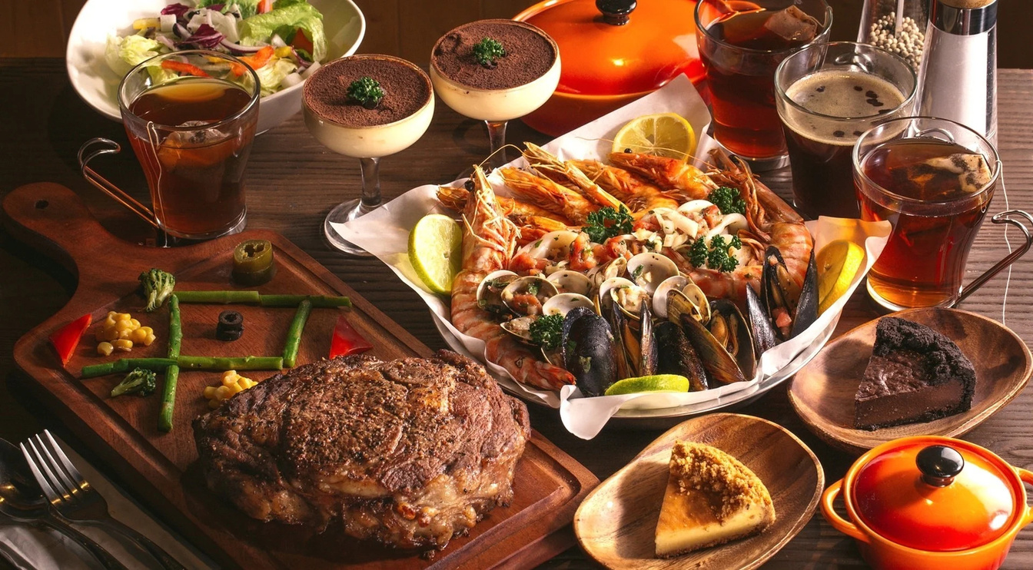

Introduction
This dataset contains restaurant transaction data, including menu details and order records. It helps analyze sales trends, popular items, and peak ordering times. Ideal for business insights, pricing strategies, and customer preferences analysis.

Slide 3
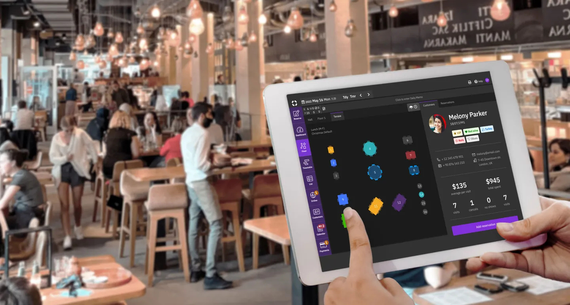

Objective :-
The objective of this data is to analyze restaurant sales, customer ordering patterns, and menu performance. Key goals include:
Sales Analysis – Track revenue trends based on menu items and order frequency.
Customer Preferences – Identify the most popular food items and categories.
Peak Order Times – Determine high-traffic hours for better staffing and inventory management.
Menu Optimization – Assess item performance to adjust pricing or promotions.
Business Decision Making – Provide insights for restaurant growth and operational efficiency.

Slide 4
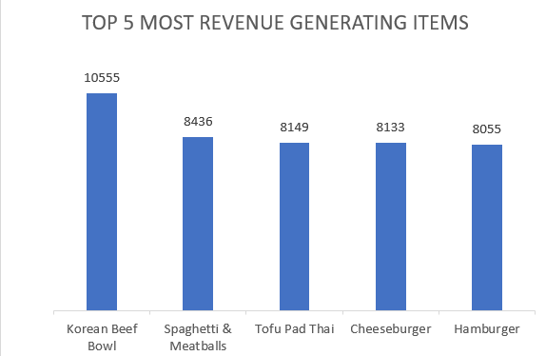
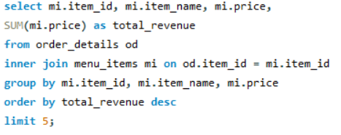
-- Q. Top 5 Revenue generating items. --
The Korean Beef Bowl is the clear top performer, contributing 24.5% of total revenue from the top 5 items. The rest are fairly close in range, each making up around 18–19%, with Hamburger slightly behind at 18.7%.

Slide 5
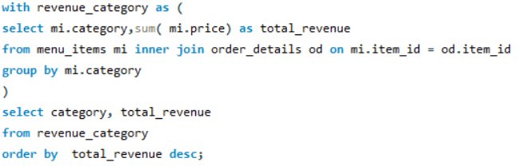
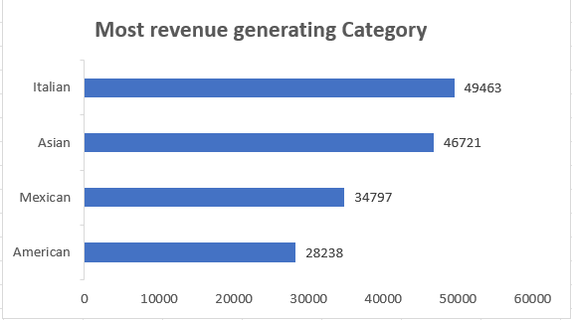
Q. Which category generate the highest revenue ?
The Italian and Asian categories dominate revenue, jointly accounting for over 60% of total category-based earnings. Italian food alone contributes 31.1%, making it the top revenue-generating category, followed closely by Asian at 29.4%. Mexican and American categories trail behind with under 22% and 18% respectively.

Slide 6
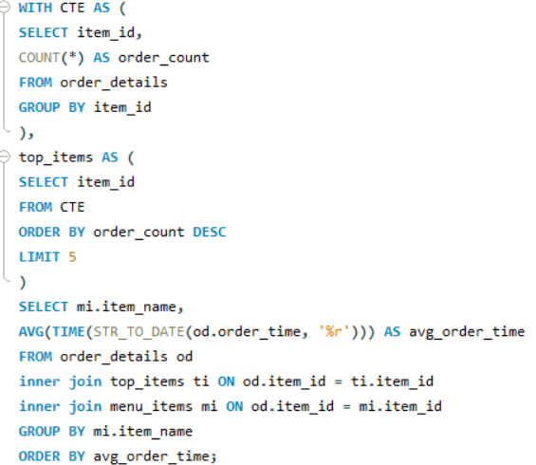
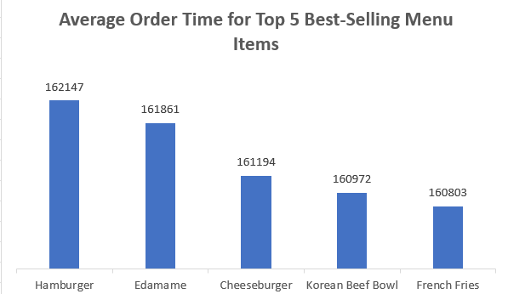
Q. What is the average order time for the top 5 most popular menu items?
The average order times across the top 5 best-selling menu items are extremely close, each hovering around 20% of the total time. Hamburger has the highest share at 20.1%, but the variation is minimal—indicating consistent preparation times across popular items.

Slide 7
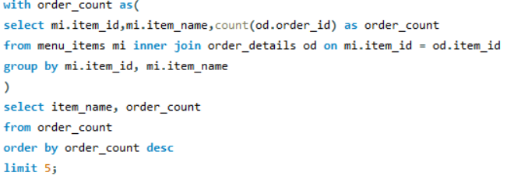
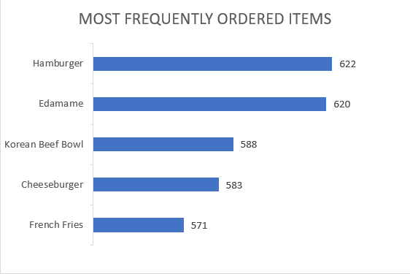
Q. Which items are the most frequently ordered ?
The Italian and Asian categories dominate revenue, jointly accounting for over 60% of total category-based earnings. Italian food alone contributes 31.1%, making it the top revenue-generating category, followed closely by Asian at 29.4%. Mexican and American categories trail behind with under 22% and 18% respectively.

Slide 8
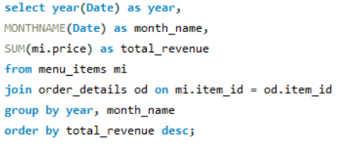
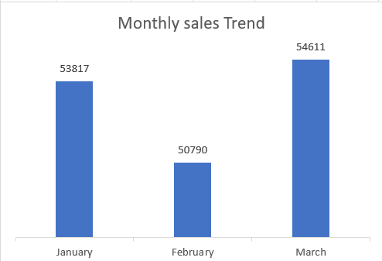
Q. What are sales trend on the basis of month in a year of restaurant ?
Sales remained relatively consistent across the three months, with March leading slightly at 34.3% of total sales. January was close behind at 33.8%, while February experienced a minor dip, contributing 31.9% of total revenue.

Slide 9
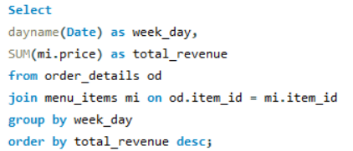
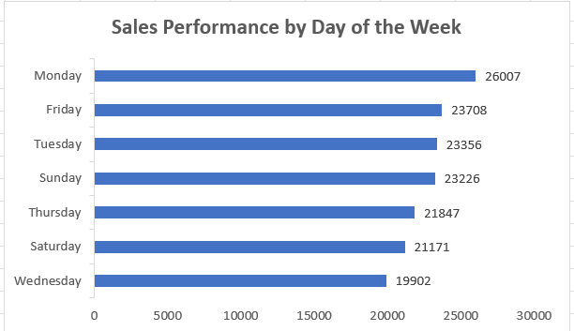
Q. Which day of week has most no of orders ?
Monday is the strongest sales day, contributing 16.3% of weekly sales. Sales then gradually decline through the week, with Wednesday being the lowest at 12.5%. The overall distribution is fairly balanced, but Mondays clearly outperform the rest.

Slide 10
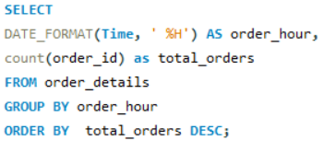
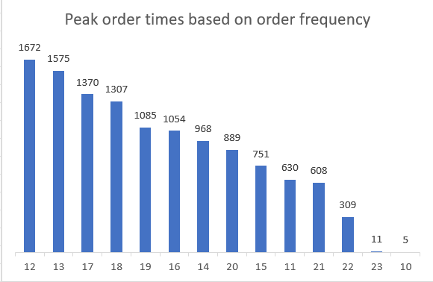
Q. What are the peak order times based on order frequency?
Order activity peaks sharply at 12 PM (12.6%) and 1 PM (11.9%), marking lunch hours as the busiest. A second wave hits around 5–6 PM, likely dinner time, with 17:00 and 18:00 hours contributing a combined 20.3%. Very few orders are placed after 9 PM, with activity nearly dropping off completely by 11 PM.

Slide 11

Recommendations:
Focus on promoting best-sellers (Hamburger, Edamame, Korean Beef Bowl) through combos and upselling. Optimize pricing & menu by reviewing underperforming items. Introduce time-based promotions to boost sales during off-peak hours. Expand popular categories to attract more customers.
Explain more about some global solutions to save the arctic here.
Explain more about some global solutions to save the arctic here.

Slide 12



THANK YOU !
for watching this presentation
Avishek Paswan
7029689216
paswanaman43@gmail.com

